Slide 1


Mission SPI4+
NAME MFI
Name auditors
Date
LOGO PARTENAIRE

Slide 2
Introductions partner/auditor

Slide 3
CERISE and Social Performance
French NGO actively promoting social performance in microfinance sector since 2001
In 2004, created Social Performance Indicators tool (SPI) to assess performance of MFI partners
Since 2008, broadening focus to include SPM for investors and social businesses
https://cerise-spm.org

Slide 4
Objectives of the social audit
  Analyse social performance practices in order to identifier strengths and areas of improvement
  Identify tools and resources to help address gaps
  Build social performance management capacity
  ADD ANY SPECIFIC OBJECTIVES

Slide 5
Objectives of this introductory workshop
Make sure we are speaking the same language
Align expectations – address concerns
Present the SPI4 and the audit process
ADD ANY SPECIFIC OBJECTIVES

Slide 6
Are we talking the same language?
What does “social performance” mean to you?
What do you understand by the term “social performance management”?

Slide 7
What do we mean by social performance?
Social Performance: The effective translation of an institution’s mission into practice in line with accepted social values.
Social Performance Management (SPM): the implementation of management practices that put into practice the social mission of the institution.
Social Performance Management
Intent
Internal systems
Outputs
Outcomes
Impact
[-----------------PROCESS--------------------------] [----------------RESULTS-------------]
Impact Assessment

Slide 8
Why is it important to manage your social performance?
Because having a mission is not the same as achieving it.
SPM ensures your organization does what it set out to do
Because it builds client and staff loyalty
Appropriate, transparent and fair products that meet client needs also help retain clients. Robust HR policies encourage staff retention
Because being transparent about your social performance is good for your reputation, and the credibility of the sector.
Because it’s good business.
Social performance positively correlated to financial performance, as sghown in 2017 MIX study where good intentions meet good business

Slide 9
What is balanced performance management?
Social performance
Financial performance
Financial performance
Social performance

Slide 10
The risks of unbalanced management
  Repercussions on clients
  Bad reputation, difficulties in attracting / retaining clients
  Products that do not meet customer needs
  Difficulties in attracting investment
Without SPM, an institution is unlikely to achieve its social mission

Slide 11
Benefits of good social performance management
  Improved customer loyalty
  Less loan default
  Improved reputation
  Less staff turnover
  Better data to make decisions
  Client well-being
With a strong SPM, an institution is more likely to improve living standards of its clients, and to improve its financial performance

Slide 12
Social Performance Management
Your social mission → you decide!
Social management practices to meet this mission→ Universal Standards for Social Performance Management

Slide 13

Universal Standards for SPM
Represent the culmination of 10 years of industry-wide collaboration, coordinated by the
to align definitions & consolidate best practice around SP management and assessment.
Notes:
Released in 2012, the Universal Standards is a comprehensive manual of best practices in SPM.
The Universal Standards are the first and only resource that draws on the many processes in the field to create a common structure and language for SPM
Globally accepted standards based on best practices from leading organizations (e.g., ILO, Smart Campaign)
Developed for and by the people in microfinance (regulators, investors, microfinance services providers, raters, auditors)
Also a resource for investor due diligence and monitoring of investees

Slide 14
The Universal Standards for SPM
Released in 2012, the Universal Standards is a comprehensive manual of best practices in SPM.
The Universal Standards are the first and only resource that draws on the many processes in the field to create a common structure and language for SPM
  Globally accepted standards based on best practices from leading organizations (e.g., ILO, Smart Campaign)
  Developed for and by the people in microfinance (regulators, investors, microfinance services providers, raters, auditors)
Also a resource for investor due diligence and monitoring of investees

Slide 15
Hierarchy within the Universal Standards
Dimensions
  The six main categories of management activity by which the manual is organized.
  19 broad statements about what the financial service provider should achieve.
Standards
  Descriptions of the 66 policies and operational practices that are necessary to achieve the standards.
Essential Practices

Slide 16
Hierarchy within the Universal Standards
Dimensions
  The six main categories of management activity by which the manual is organized.
Standards
  19 broad statements about what the financial service provider should achieve.
  Descriptions of the 66 policies and operational practices that are necessary to achieve the standards.
Essential Practices

Slide 17
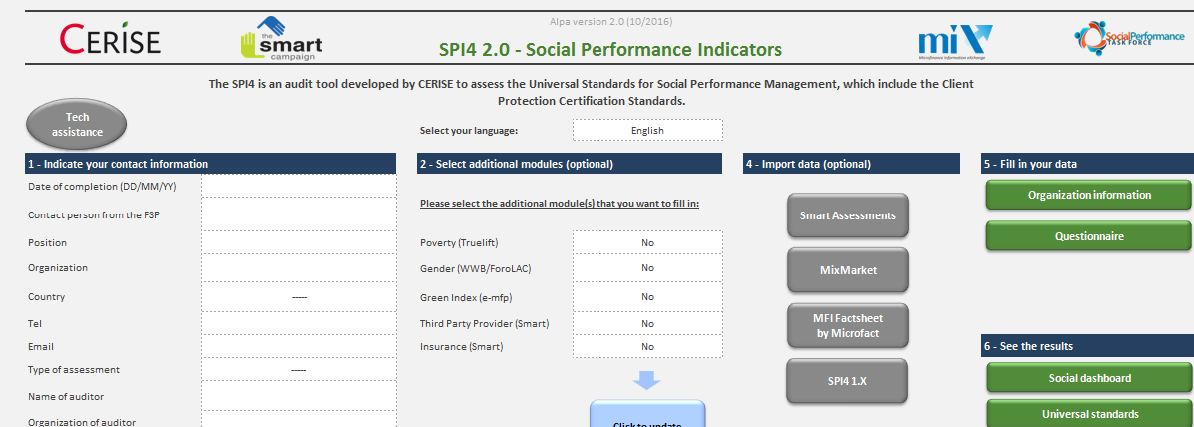
Assessing social performance management
Dimensions
Standards
Essential Practices
Indicators

Slide 18
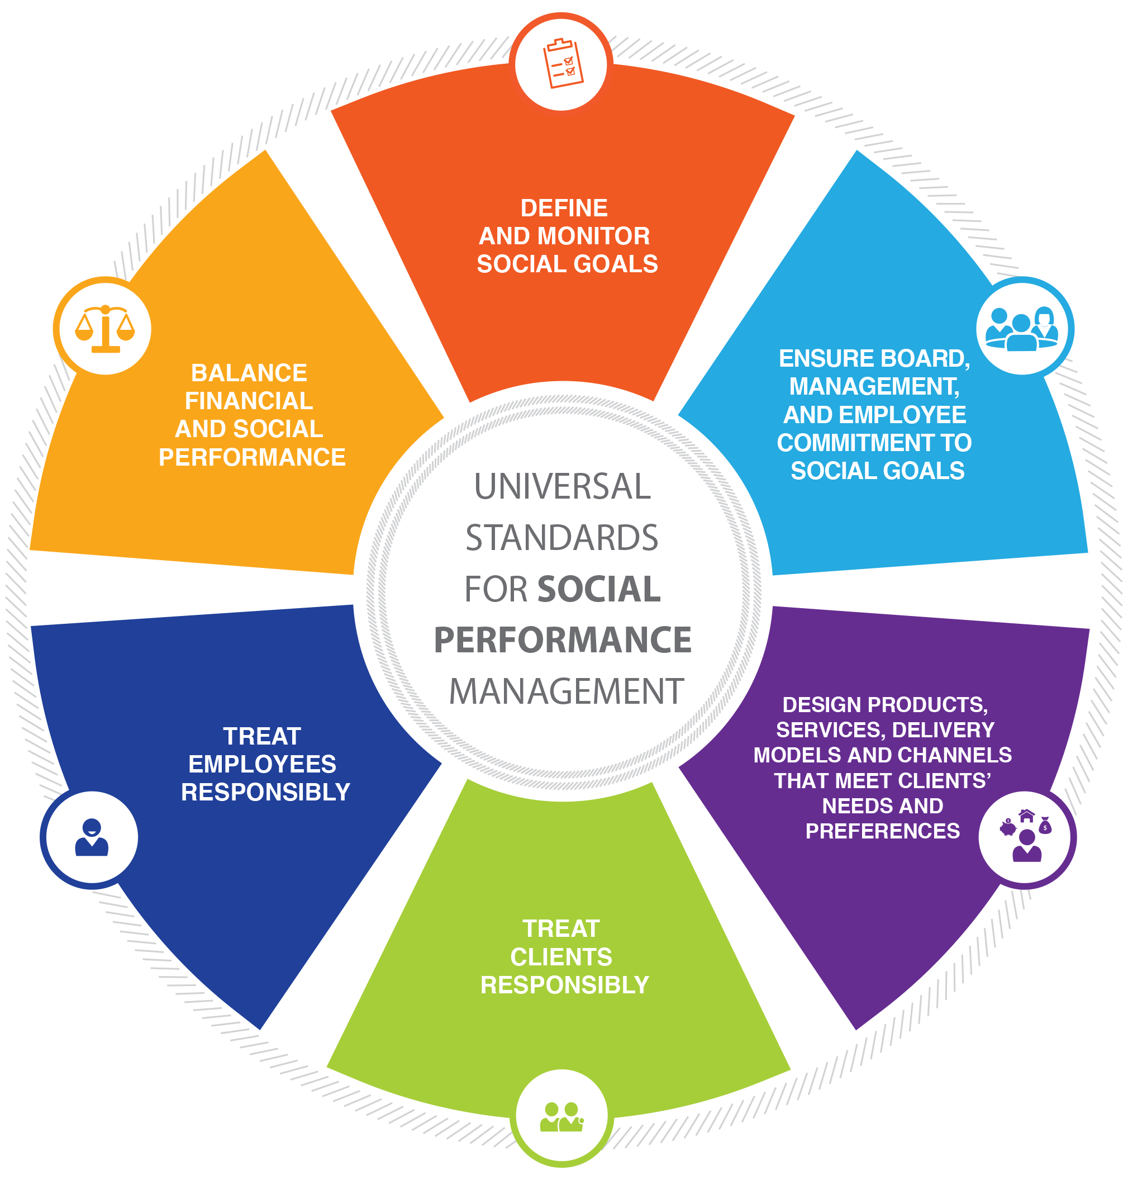

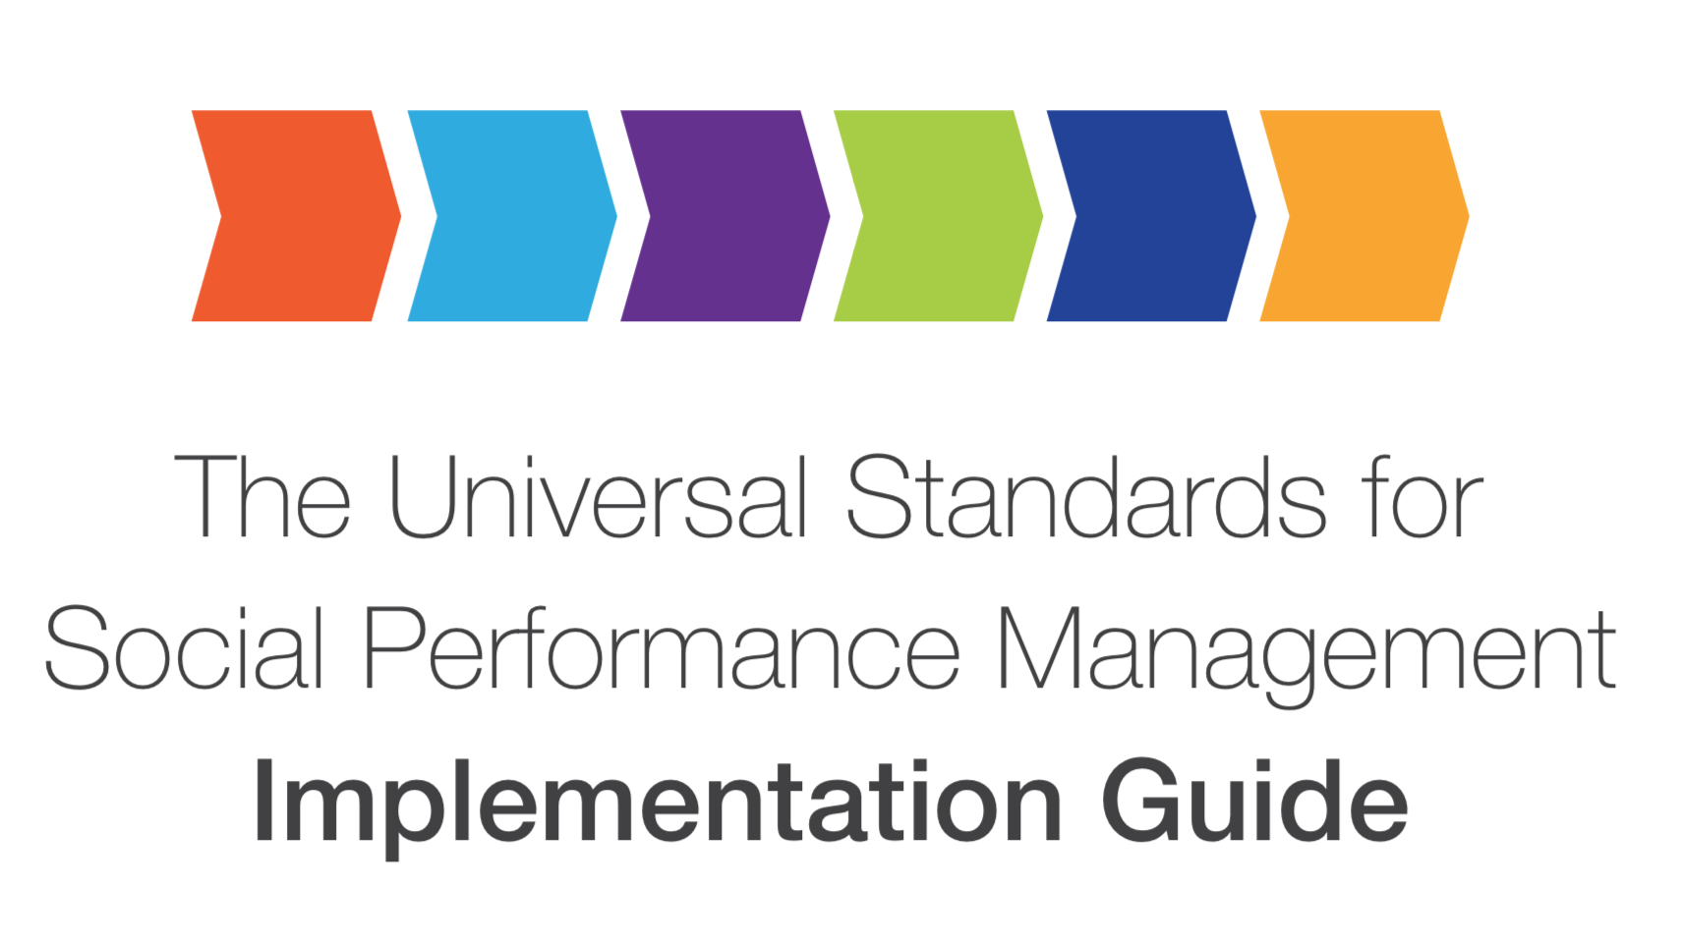
A management tool
The only assessment tool aligned the Universal Standards
Customizable, thanks to optional modules on poverty, gender, and environment
A learning tool that allows institutions to identify gaps and improve on them, thanks to technical resources linked to each Essential Practice

Slide 19

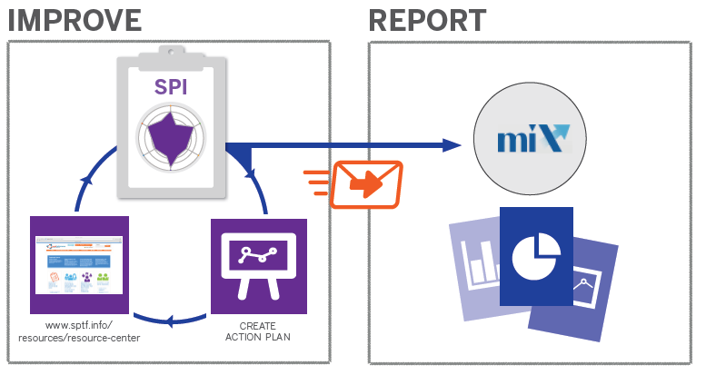










A tool to streamline reporting
And…Investors due dill!
Each initiative = a different report
SPI4 standardizes reporting across actors

Slide 20

What to do with the results?
Internally
Prioritize areas of improvement and create an action plan
Report on your results to the Board –social dashboard
Compare to peer benchmarks (CERISE database)
Externally
  Tell your investors/partners…it will save you and them time
  Communicate/case studies of good practices
  Report to MIX (can be done directly by CERISE)
Notes:
.

Slide 21
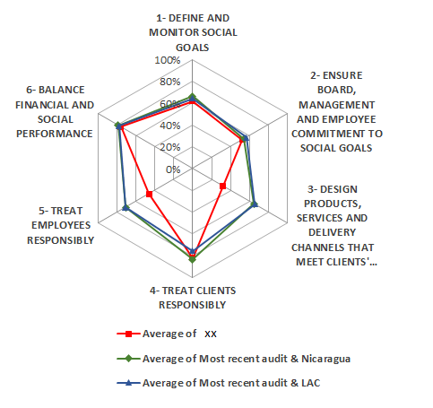
A tool that allows benchmarking
SPI4 average score by dimension
 | Average of xx | Average of Nicaragua | Average of LAC region
Number of audits | 1 | 10 | 98
DIM 1- DEFINE AND MONITOR SOCIAL GOALS | 62% | 66% | 64%
DIM 2- COMMITMENT TO SOCIAL GOALS | 53% | 54% | 57%
DIM 3- DESIGN PRODUCTS THAT MEET CLIENT'S NEEDS | 32% | 65% | 66%
DIM 4 - TREAT CLIENTS RESPONSIBLY | 82% | 83% | 76%
DIM 5 - TREAT EMPLOYEES RESPONSIBLY | 46% | 71% | 71%
DIM 6 - BALANCE FINANCIAL AND SOCIAL PERFORMANCE | 76% | 79% | 78%
Total | 59% | 70% | 69%
Download the SPI4 benchmark table
https://cerise-spm.org

Slide 22
Your perspective
What is the social mission of NAME MFI?
In your opinion, what are the biggest challenges facing NAME MFI in terms of achieving this mission?
What do you expect from this social audit?

Slide 23

Objectives of the SPI4 audit and expectations

Slide 24
Agenda of the audit

Slide 25
Share your expectations (MFI - partner / auditor)

Slide 26
Thank you for your attention
Name
email
LOGO PARTENAIRE

